Slide 1
14 – Decision Analytics Thinking
Dave Eargle – CU Boulder

Slide 2
Evaluation
How do we measure generalization performance?

Slide 3
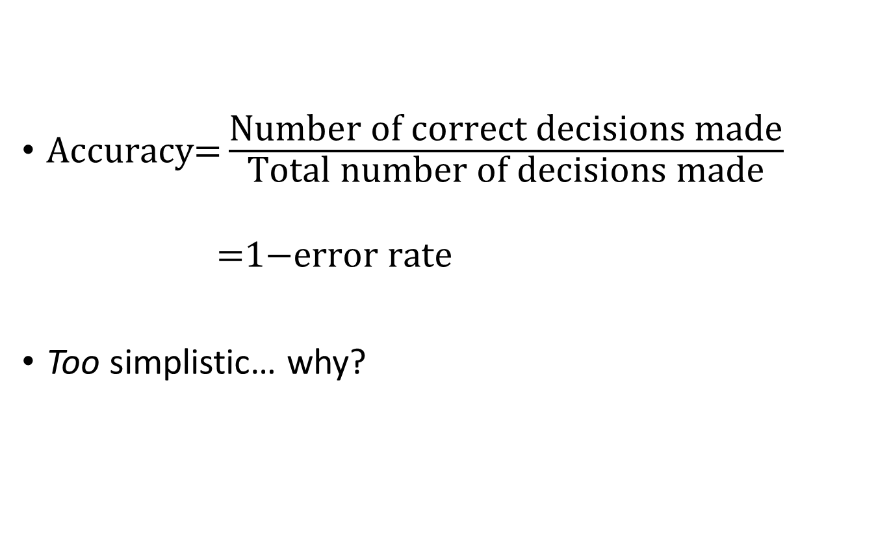
Evaluating Classifiers: Plain Accuracy
$\text{Accuracy}\text{=}\frac{\text{Number} \text{of} \text{correct} \text{decisions} \text{made}}{\text{Total} \text{number} \text{of} \text{decisions} \text{made}}$
$$\text{ =1−}\text{error} \text{rate}$$
Too simplistic… why?

Slide 4
Why accuracy can’t compare classifiers based on different priors
Data scientist 1 and Data scientist 2 both use a classifier that simply predicts the majority class for every datapoint.
Data scientist 1 gets an accuracy of 95%
Data scientist 2 gets an accuracy of 50%
How could this be?

Slide 5

Evaluating Classifiers: The Confusion Matrix
A confusion matrix for a problem involving $n$ classes is an $n×n$ matrix,
with the columns labeled with actual classes and the rows labeled with predicted classes
It separates out the decisions made by the classifier,
making explicit how one class is being confused for another
The errors of the classifier are the false positives and false negatives
Actual
 | p | n
Y | True Positives | False Positives
N | False Negatives | True Negatives
Predicted

Slide 6
Why do we need a confusion matrix to evaluate our classifiers -- why is accuracy too simplistic?
What would a false negative (FN) and a false positive (FP) look like in each of the following cases?
case of flu diagnosis
case of terrorism video flagging (bbc; inverse)
case of a self-driving car identifying red lights
case of sending someone to prison
case of terrorism and mass surveillance
Are the two types of errors equally problematic?
What if there are only 10 positives for every 10,000,000 negatives – what would be a good way to get ultra-high accuracy?

Slide 7
Building a Confusion Matrix
“Default” on a loan
Y, N = predicted
p, n = actual
Default Truth | Model Prediction
0 | 0
1 | 1
0 | 1
0 | 1
0 | 0
1 | 1
0 | 0
0 | 0
1 | 1
1 | 0
 |  | Predicted class
 |  | Y | N | Total
Actual class | p | 3 | 1 | 4
 | n | 2 | 4 | 6
 | Total | 5 | 5 | 10
Default = 1
No Default = 0

Slide 8
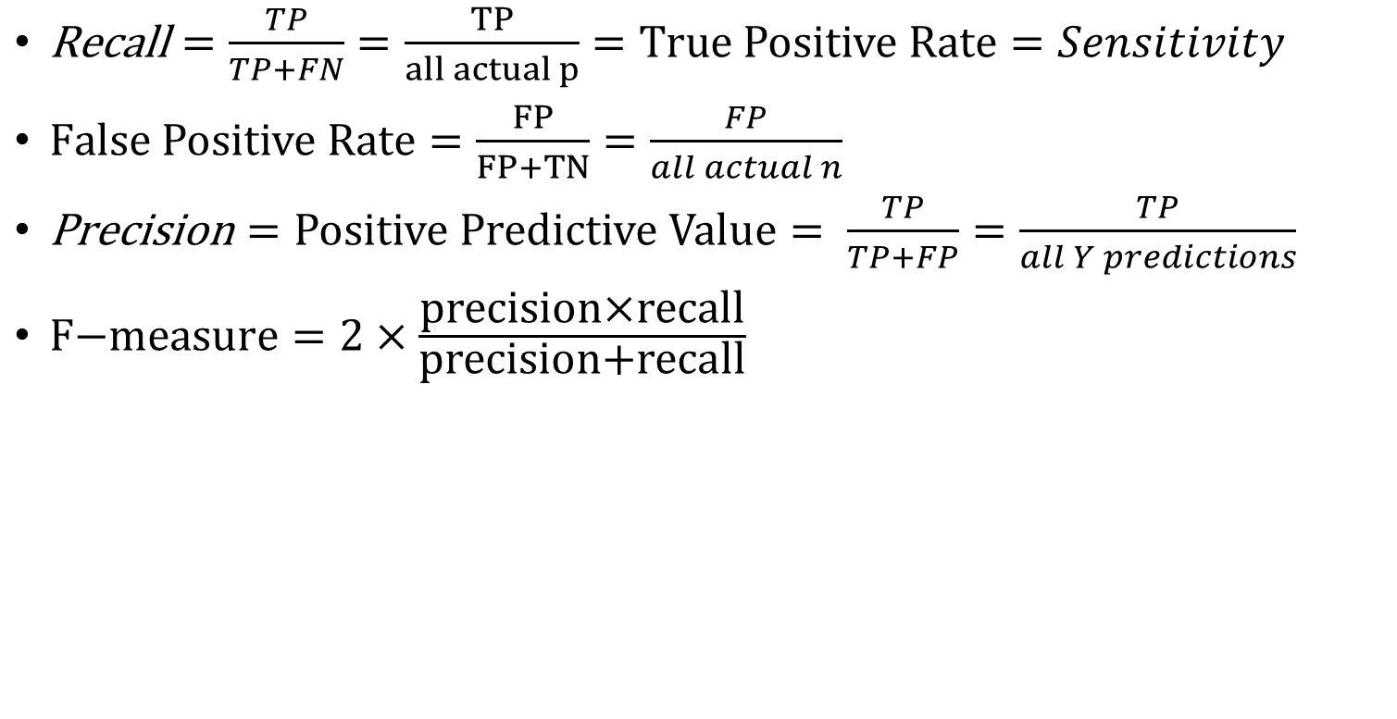
Some Evaluation Metrics
$\text{Recall}=\frac{TP}{TP+FN}=\frac{TP}{all actual p}=True Positive Rate=Sensitivity$
$False Positive Rate=\frac{FP}{FP+TN}=\frac{FP}{all actual n}$
$\text{Precision}=Positive Predictive Value= \frac{TP}{TP+FP}=\frac{TP}{all Y predictions}$
$\text{F}\text{−}\text{measure}=2×\frac{\text{precision}\text{×}\text{recall}}{\text{precision}\text{+}\text{recall}}$

Slide 9
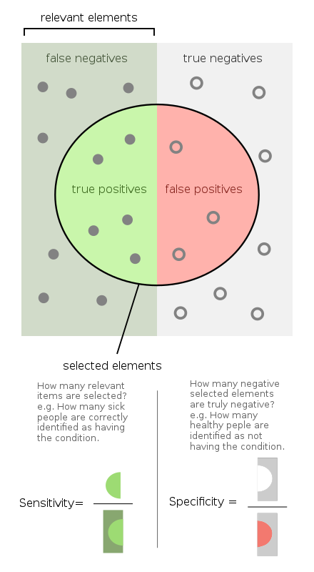
Sensitivity and Specificity
https://en.wikipedia.org/wiki/Sensitivity_and_specificity
“selected elements” are all positive predictions
Everything in the left green bar are actual positive
Everything in the right grey bar are actual negatives

Slide 10
Sensitivity (True Positive Rate)?
“Default” on a loan
Y, N = predicted
p, n = actual
 |  | Predicted class
 |  | Y | N | Total
Actual class | p | 3 | 1 | 4
 | n | 2 | 4 | 6
 | Total | 5 | 5 | 10

Slide 11
Positive Predictive Value?
“Default” on a loan
Y, N = predicted
p, n = actual
 |  | Predicted class
 |  | Y | N | Total
Actual class | p | 3 | 1 | 4
 | n | 2 | 4 | 6
 | Total | 5 | 5 | 10

Slide 12
False Positive Rate?
“Default” on a loan
Y, N = predicted
p, n = actual
 |  | Predicted class
 |  | Y | N | Total
Actual class | p | 3 | 1 | 4
 | n | 2 | 4 | 6
 | Total | 5 | 5 | 10

Slide 13
Expected Value Framework
Quantifying the benefits and costs of correct and incorrect predictions

Slide 14
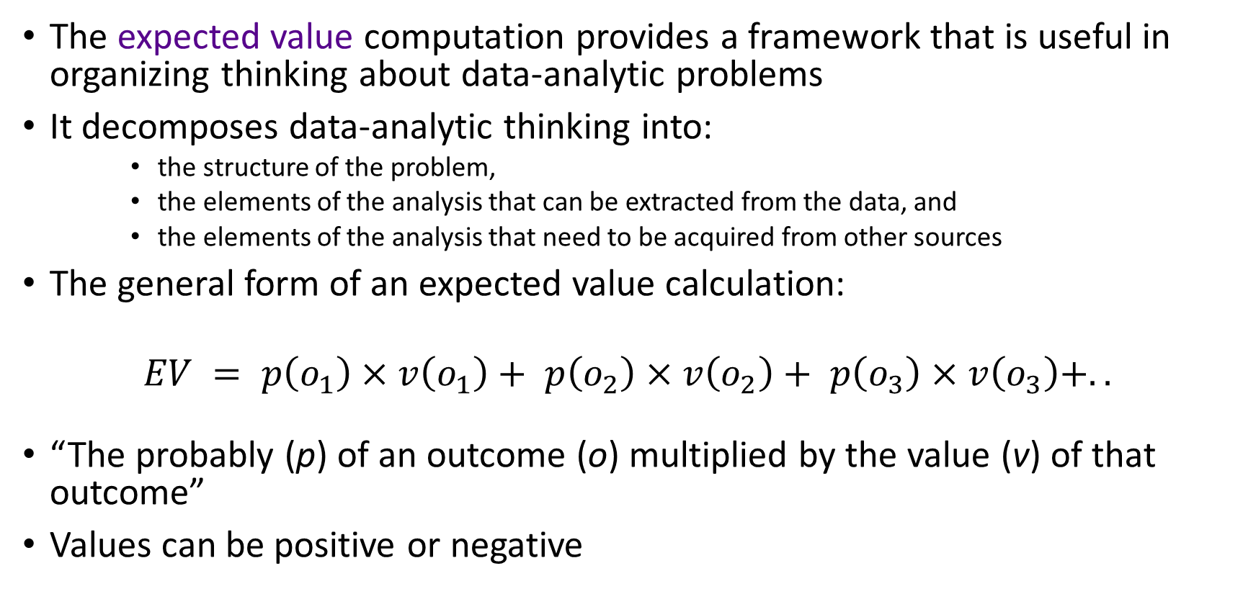
A Key Analytical Framework: Expected Value
The expected value computation provides a framework that is useful in organizing thinking about data-analytic problems
It decomposes data-analytic thinking into:
the structure of the problem,
the elements of the analysis that can be extracted from the data, and
the elements of the analysis that need to be acquired from other sources
The general form of an expected value calculation:
$$EV = p\left(o_{1}\right)×v\left(o_{1}\right)+ p\left(o_{2}\right)×v\left(o_{2}\right)+ p\left(o_{3}\right)×v\left(o_{3}\right)+..$$
“The probably (p) of an outcome (o) multiplied by the value (v) of that outcome”
Values can be positive or negative

Slide 15
Uses of the Expected Value Framework
There are two uses:
Inform how to use our classifier for individual predictions… what cutoff threshold?
Compare classifiers… which gives more value, given its performance?

Slide 16
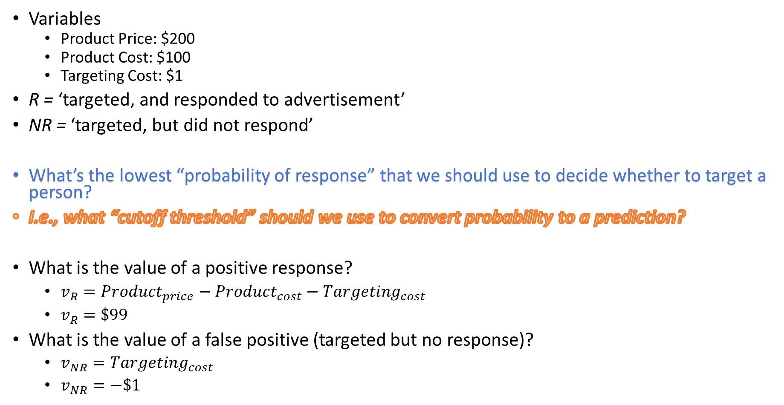
Expected Value Framework in Use Phase
Variables
Product Price: $200
Product Cost: $100
Targeting Cost: $1
R = ‘targeted, and responded to advertisement’
NR = ‘targeted, but did not respond’
What’s the lowest “probability of response” that we should use to decide whether to target a person?
I.e., what “cutoff threshold” should we use to convert probability to a prediction?
What is the value of a positive response?
$v_{R}=Product_{price}−Product_{cost}−Targeting_{cost}$
$v_{R}=\$99$
What is the value of a false positive (targeted but no response)?
$v_{NR}=Targeting_{cost}$
$v_{NR}=−\$1$

Slide 17
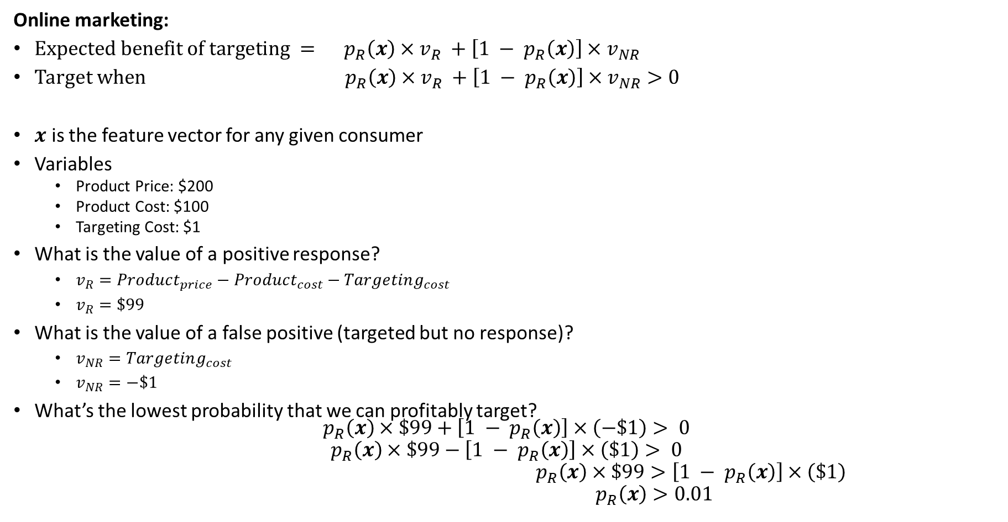
Expected Value Framework in Use Phase
You calculate expected value for each choice you might make. In this case, only one choice has any monetary impact – if we choose to target. So we compare it to 0.
Online marketing:
$\text{Expected} \text{benefit} \text{of} \text{targeting} = p_{R}\left(x\right)×v_{R} +\left[1 − p_{R}\left(x\right)\right]×v_{NR}$
Target when $p_{R}\left(x\right)×v_{R} +\left[1 − p_{R}\left(x\right)\right]×v_{NR}>0$
$x$ is the feature vector for any given consumer
Variables
Product Price: $200
Product Cost: $100
Targeting Cost: $1
What is the value of a positive response?
$v_{R}=Product_{price}−Product_{cost}−Targeting_{cost}$
$v_{R}=\$99$
What is the value of a false positive (targeted but no response)?
$v_{NR}=Targeting_{cost}$
$v_{NR}=−\$1$
What’s the lowest probability that we can profitably target?
$$p_{R}\left(x\right)×\$99+\left[1 − p_{R}\left(x\right)\right]×\left(−\$1\right)> 0$$
$$p_{R}\left(x\right)×\$99−\left[1 − p_{R}\left(x\right)\right]×\left(\$1\right)> 0$$
$${ p}_{R}\left(x\right)×\$99>\left[1 − p_{R}\left(x\right)\right]×\left(\$1\right) \\ { p}_{R}\left(x\right)>0.01$$

Slide 18
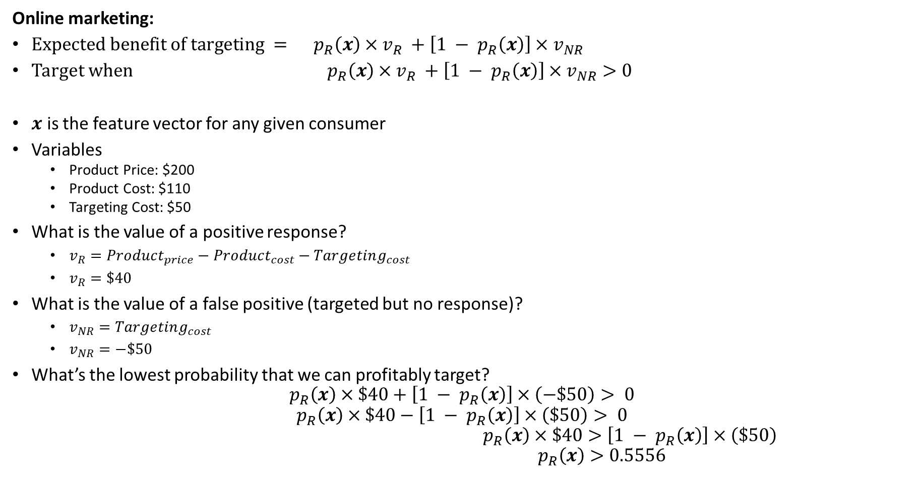
Expected Value Framework in Use Phase
Online marketing:
$\text{Expected} \text{benefit} \text{of} \text{targeting} = p_{R}\left(x\right)×v_{R} +\left[1 − p_{R}\left(x\right)\right]×v_{NR}$
Target when $p_{R}\left(x\right)×v_{R} +\left[1 − p_{R}\left(x\right)\right]×v_{NR}>0$
$x$ is the feature vector for any given consumer
Variables
Product Price: $200
Product Cost: $110
Targeting Cost: $50
What is the value of a positive response?
$v_{R}=Product_{price}−Product_{cost}−Targeting_{cost}$
$v_{R}=\$40$
What is the value of a false positive (targeted but no response)?
$v_{NR}=Targeting_{cost}$
$v_{NR}=−\$50$
What’s the lowest probability that we can profitably target?
$$p_{R}\left(x\right)×\$40+\left[1 − p_{R}\left(x\right)\right]×\left(−\$50\right)> 0$$
$$p_{R}\left(x\right)×\$40−\left[1 − p_{R}\left(x\right)\right]×\left(\$50\right)> 0$$
$${ p}_{R}\left(x\right)×\$40>\left[1 − p_{R}\left(x\right)\right]×\left(\$50\right) \\ { p}_{R}\left(x\right)>0.5556$$

Slide 19
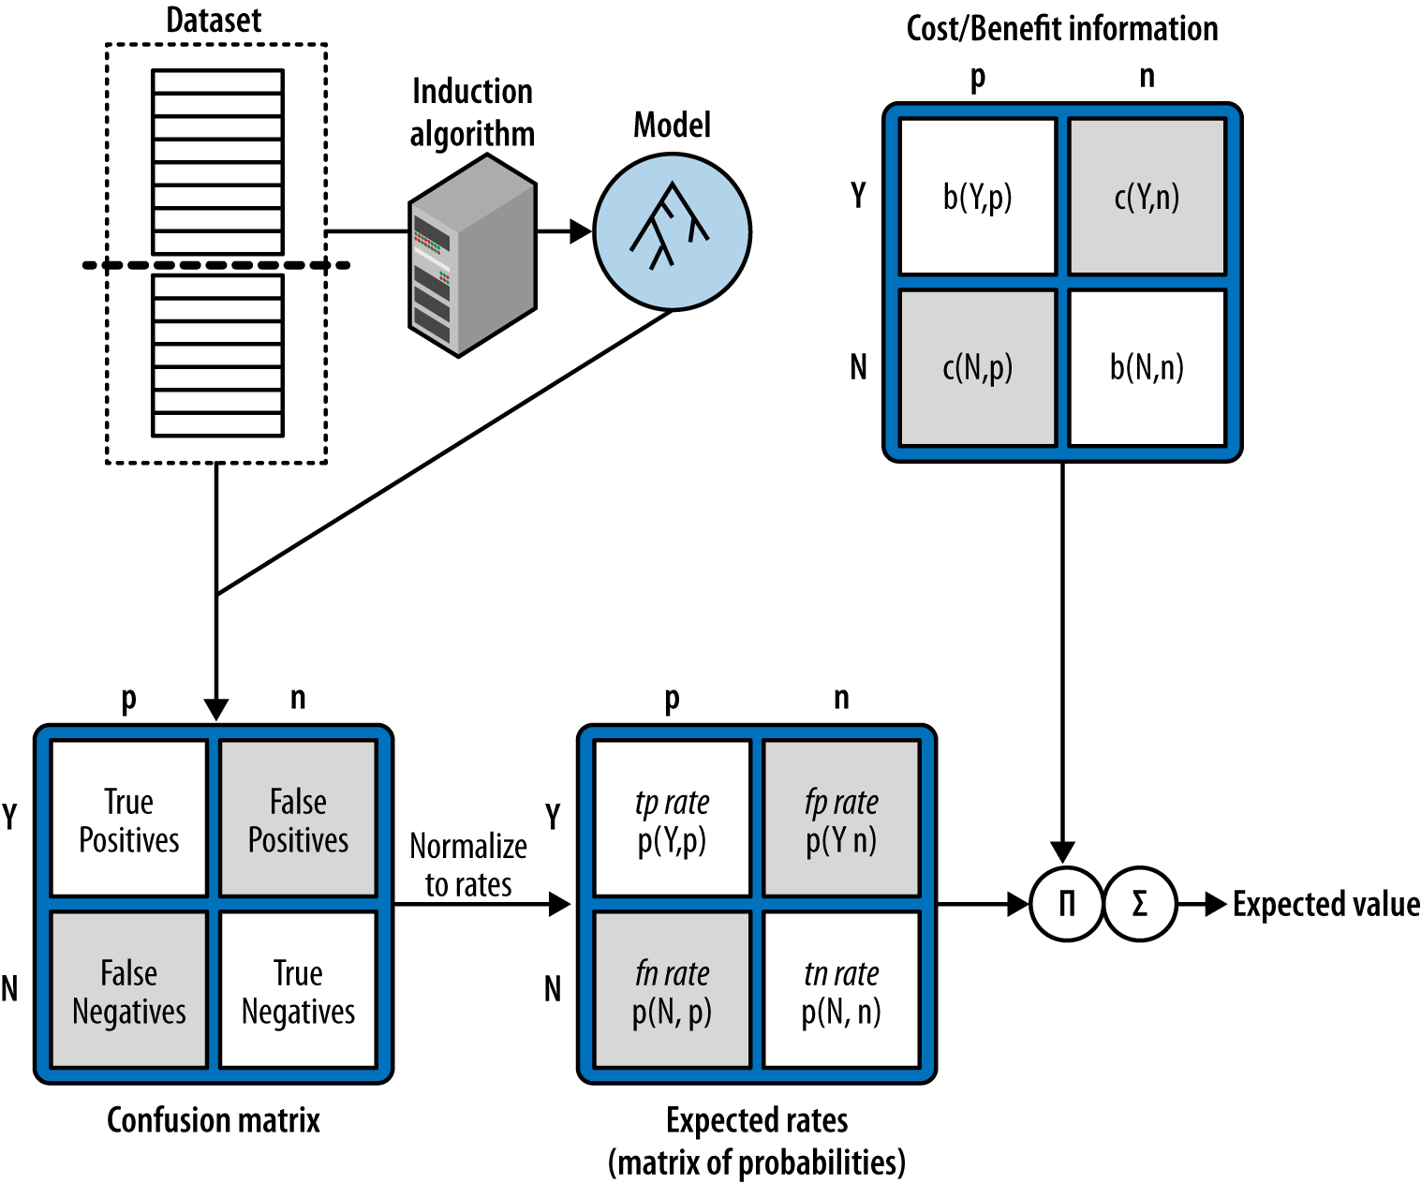
Using Expected Value to Frame Classifier Evaluation
Convention is that capital letters are “predictions”, lower case are “actuals”
Y,N = predictions
p, n = actuals

Slide 20
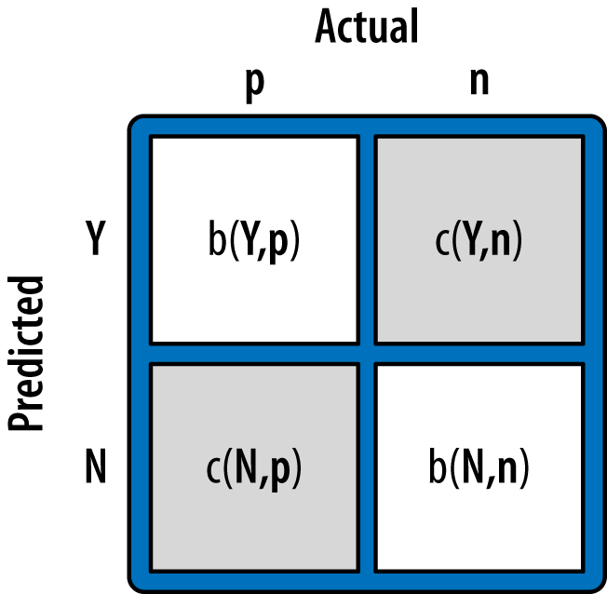
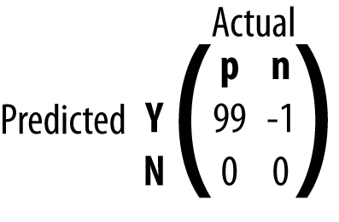
A cost-benefit matrix
The marketing example
Product Price: $200
Product Cost: $100
Targeting Cost: $1
Convention is that CAPITAL LETTERS are “predictions”, lower case are “actuals”
Y,N = predictions
p, n = actuals

Slide 21
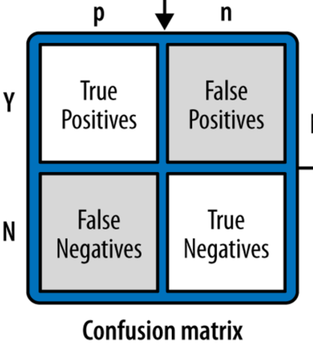
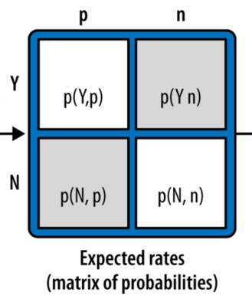

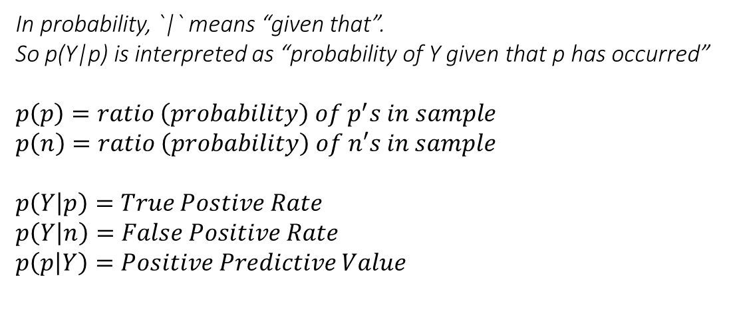

Conditional Probability
p(x, y) = probability of x and y co-occurring
$$p\left(Y,p\right)=\frac{count\left(Y,p\right)}{T}=\frac{TP count}{Total}$$
A rule of basic probability is:
$$p\left(x, y\right)= p\left(y\right)∗p(x | y)$$
So we can do
$$p\left(Y,p\right)=p\left(p\right) ∗p\left(Y | p\right)$$
In probability, `|` means “given that”.
So p(Y|p) is interpreted as “probability of Y given that p has occurred”
$$p\left(p\right)=ratio \left(probability\right) of p^{′}s in sample$$
$$p\left(n\right)=ratio \left(probability\right) of n′s in sample$$
$$p\left(Y | p\right)=True Postive Rate$$
$$p\left(Y | n\right)=False Positive Rate$$
$$p\left(p | Y\right)=Positive Predictive Value$$
 | p | n
Y | 56 | 7
N | 5 | 42
Convention is that capital letters are “predictions”, lower case are “actuals”
Y,N = predictions
p, n = actuals

Slide 22
Conditional Probability
p(x, y) = probability of x and y co-occurring
$$p\left(Y,p\right)=\frac{count\left(Y,p\right)}{T}=\frac{TP count}{Total}$$
56/T
7/T
A rule of basic probability is:
$$p\left(x, y\right)= p\left(y\right)∗p(x | y)$$
So we can do
$$p\left(Y,p\right)=p\left(p\right) ∗p\left(Y | p\right)$$
5/T
42/T
T = 110
In probability, `|` means “given that”.
So p(Y|p) is interpreted as “probability of Y given that p has occurred”
$$p\left(p\right)=ratio \left(probability\right) of p^{′}s in sample$$
$$p\left(n\right)=ratio \left(probability\right) of n′s in sample$$
$$p\left(Y | p\right)=True Postive Rate$$
$$p\left(Y | n\right)=False Positive Rate$$
$$p\left(p | Y\right)=Positive Predictive Value$$
 | p | n
Y | 56 | 7
N | 5 | 42
Probability of Y given p
i.e., “Only considering the p’s, what is the chance of Y?”
Convention is that capital letters are “predictions”, lower case are “actuals”
Y,N = predictions
p, n = actuals

Slide 23




Conditional Probability
Without the rewrite, the cells are dependent on class priors, i.e., dependent on the ratio of actual y’s to n’s in the training dataset
$$p\left(p\right) ∗p\left(Y | p\right)$$
$$p\left(n\right) ∗p\left(Y | n\right)$$
Equivalent to…
$$p\left(p\right) ∗p\left(N | p\right)$$
$$p\left(n\right) ∗p\left(N | n\right)$$
Convention is that capital letters are “predictions”, lower case are “actuals”
Y,N = predictions
p, n = actuals

Slide 24
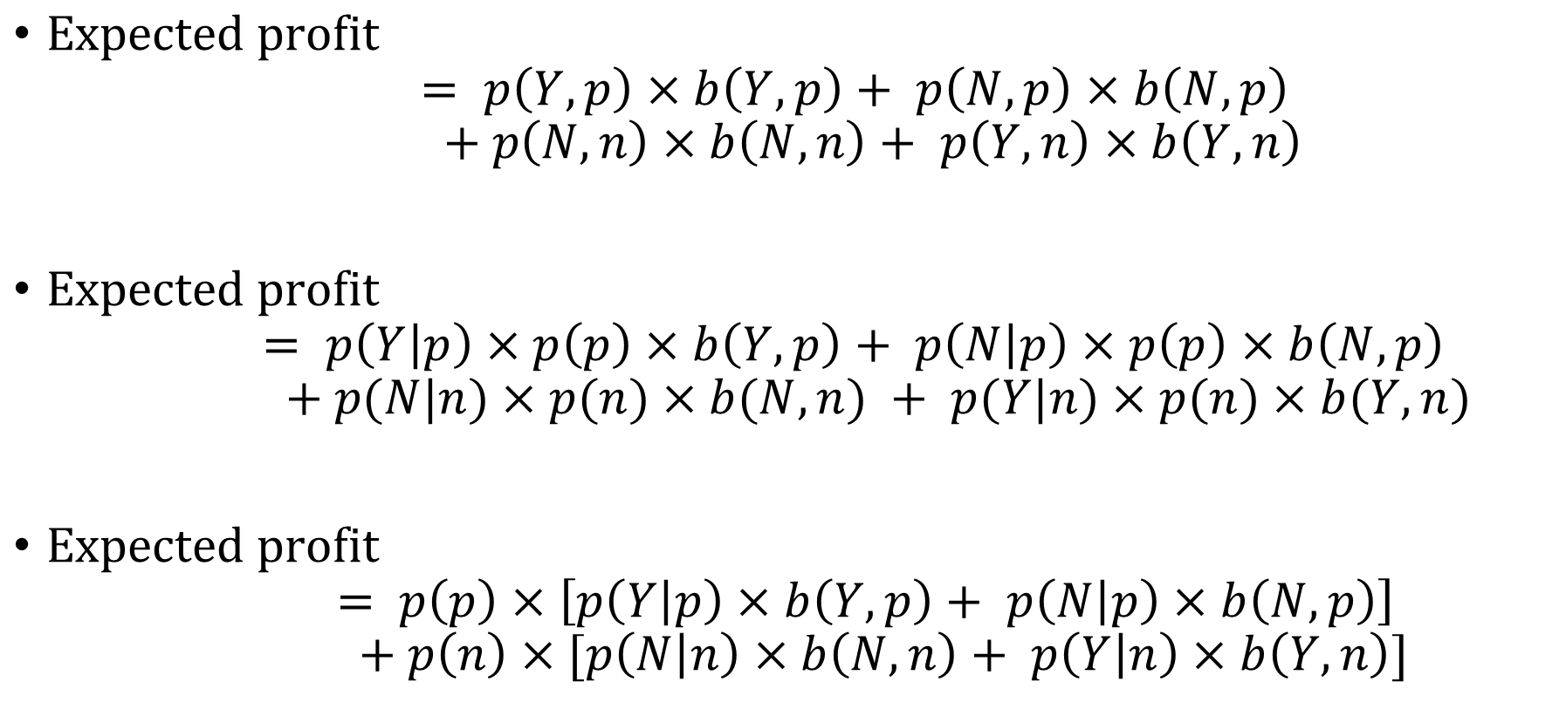
Using Expected Value to Frame Classifier Evaluation
$\text{Expected} \text{profit}$ $= p\left(Y,p\right)×b\left(Y,p\right)+ p\left(N,p\right)×b\left(N,p\right)$ $+ p\left(N,n\right)×b\left(N,n\right)+ p\left(Y,n\right)×b\left(Y,n\right)$
$\text{Expected} \text{profit}$ $= p\left(Y | p\right)×p\left(p\right)×b\left(Y, p\right)+ p\left(N | p\right)×p\left(p\right)×b\left(N,p\right)$ $+ p(N|n)×p(n)×b(N,n) + p(Y|n)×p(n)×b(Y,n)$
$\text{Expected} \text{profit}$ $= p\left(p\right)×\left[p\left(Y | p\right)×b\left(Y,p\right)+ p\left(N | p\right)×b\left(N,p\right)\right]$ $+ p\left(n\right)×[p\left(N | n\right)×b\left(N,n\right)+ p\left(Y | n\right)×b\left(Y,n\right)]$
The whole point of this rewrite was to factor out class priors. Why would we want to do this?

Slide 25
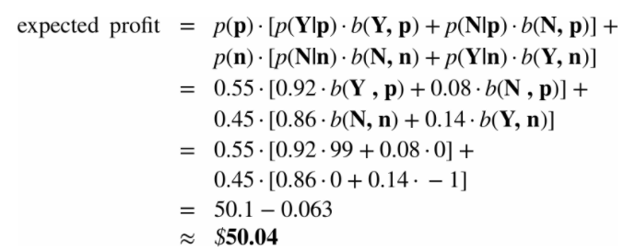
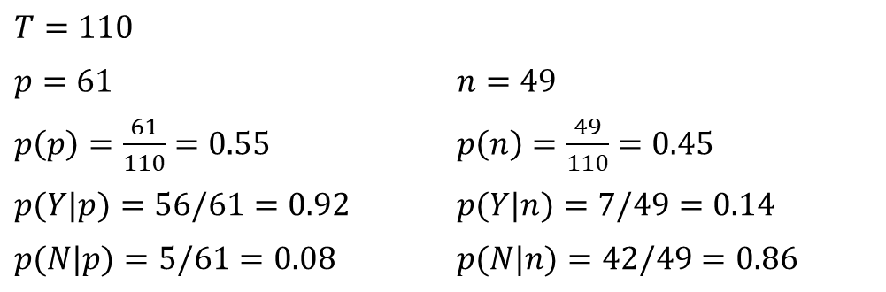
Using Expected Value to Frame Classifier Evaluation
$T=110$
$p=61$ | $n=49$
$p\left(p\right)=\frac{61}{110}=0.55$ | $p\left(n\right)=\frac{49}{110}=0.45$
$p(Y|p)=56/61=0.92$ | $p(Y|n)=7/49=0.14$
$p(N|p)=5/61=0.08$ | $p(N|n)=42/49=0.86$
 | p | n
Y | 56 | 7
N | 5 | 42
Convention is that capital letters are “predictions”, lower case are “actuals”
Y,N = predictions
p, n = actuals
Per person. So if you wanted to, you can multiply this by T to get total expected value for all people.
Compare – what would be the total expected value for an algorithm that simply targeted everyone?

Slide 26
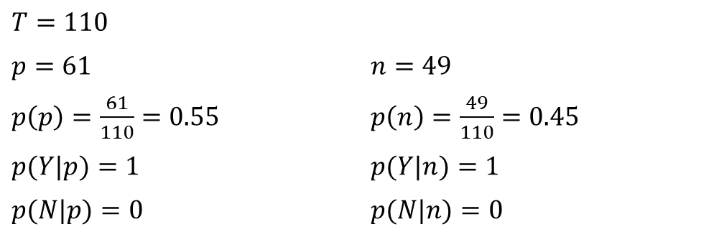

Compare – what would be the total expected value for an algorithm that simply targeted everyone?
$T=110$
$p=61$ | $n=49$
$p\left(p\right)=\frac{61}{110}=0.55$ | $p\left(n\right)=\frac{49}{110}=0.45$
$p(Y|p)=1$ | $p(Y|n)=1$
$p(N|p)=0$ | $p(N|n)=0$
 | p | n
Y | 61 | 49
N | 0 | 0
$$\text{expected} \text{profit}\text{ = }$$
$$p\left(p\right)∗\left[p\left(Y | p\right)∗b\left(Y,p\right)+p\left(N | p\right)∗b\left(N,p\right)\right]+$$
$$p\left(n\right)∗[p\left(N | n\right)∗b\left(N,n\right)+p\left(Y | n\right)∗b\left(Y,n\right)]$$
$$=p\left(p\right)∗\left[(1∗99)+(0∗0)\right]+$$
$$p\left(n\right)∗[(0∗0)+(1∗−1)]$$
$$=.55∗\left[99\right]+.45∗(−1)$$
$$=\$54.00$$
Convention is that capital letters are “predictions”, lower case are “actuals”
Y,N = predictions
p, n = actuals
Per person. So if you wanted to, you can multiply this by T to get total expected value for all people.
Superior to the model on previous slide! … but highly dependent on class priors!

Slide 27
Many figures in this slide deck from Provost, F., & Fawcett, T. (2013). Data science for business: what you need to know about data mining and data-analytic thinking. Sebastopol, Calif.: O'Reilly.

